Slide 1
Object Based Database

Slide 2
Objects
Object types and related object-oriented features such as variable-length arrays and nested tables provide higher-level ways to organize and access data in the database.
Underneath the object layer, data is still stored in columns and tables, but you are able to work with the data in terms of the real-world entities, such as customers and purchase orders, that make the data meaningful.
In general, the object-type model is similar to the class mechanism found in C++ and Java.
Like classes, objects make it easier to model complex, real-world business entities and logic, and the reusability of objects makes it possible to develop database applications faster and more efficiently.
By natively supporting object types in the database, Oracle enables application developers to directly access the data structures used by their applications.
No mapping layer is required between client-side objects and the relational database columns and tables that contain the data.
Object abstraction and the encapsulation of object behaviors also make applications easier to understand and maintain.

Slide 3
Why Object Database Management System?
Object Database Management System allows you to organize data the way applications look upon it.
It succeeds to establish a one-to-one corresponds between a database object and a real world object.
In relational database management system,
‘data models business’
In object database management system,
‘data are business’.

Slide 4
Object database management systems
Object database systems are of two kinds:
Object-oriented database management systems
Object-relational database management systems

Slide 5
Object-oriented database management systems
Object-oriented database system is an extension of object-oriented programming language to incorporate DBMS functionalities such as persistent object, Integrity constraints, Recovery from failure, transaction management, query processing.
Commercial products - ObjectStore, Objectivity/DB, GemStone, db4o, Giga Base, Zope object database
These systems support object definition language (ODL) for creating the database structure and object query language(OQL) for querying the database.

Slide 6
Object-relational database management systems
Object-relational database system is an extension of relational database system to support object-oriented features.
Commercial products: Oracle, DB2, Informix, PostgreSQL (UC Berkeley research project) etc.

Slide 7
Object-relational database management systems
Object-relational database system supports Complex Types (apart from atomic type)
Complex type – Any type which not a primitive data type is called a complex data type.
Complex data type
Arrays
Nested tables
Object type (An object type is a user-defined data type)
Reference type
Large objects (Documents, Image, Audio, Video)

Slide 8
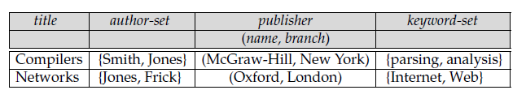
Object-relational database management systems
BOOK

Slide 9
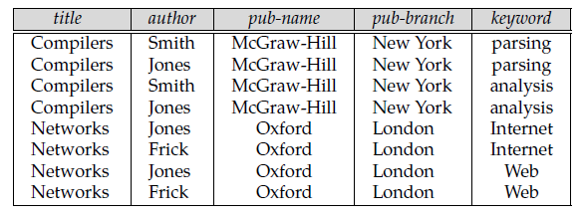
1NF representation
BOOK table in normalized form
title →→ author
title →→ keyword
title → {pub-name, pub-branch}

Slide 10
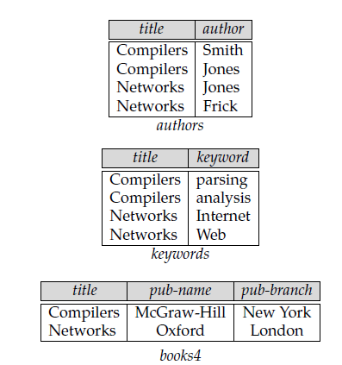
4NF representation

Slide 11
Implementation of BOOK table in ORDBMS (Oracle)
Create or replace type author_va as varray(4) of varchar(20)
/
Create or replace type keyword_va as varray(4) of varchar(10)
/
Create or replace type publisher_ty as object (
name varchar(20), branch varchar(20) )
/

Slide 12
Create or replace type book_ty as object (
title varchar(20),
authors author_va,
publisher publisher_ty,
keywords keyword_va
)
/
Create table book of book_ty;

Slide 13
Data entry
Insert into book values (book_ty(‘Compilers’, author_va(‘Smith’, ‘Jones’, null, null), publisher_ty(‘McGraw-Hill’, ‘New York’), keyword_va(‘parsing’, ‘analysis’, null, null) );

Slide 14
Alternatively, you could write
Create table book (
title varchar(20),
authors author_va,
publisher publisher_ty,
keywords keyword_va
);
Insert into book values (‘Compilers’, author_va(‘Smith’, ‘Jones’, null, null), publisher_ty(‘McGraw-Hill’, ‘New York’), keyword_va(‘parsing’, ‘analysis’, null, null));

Slide 15
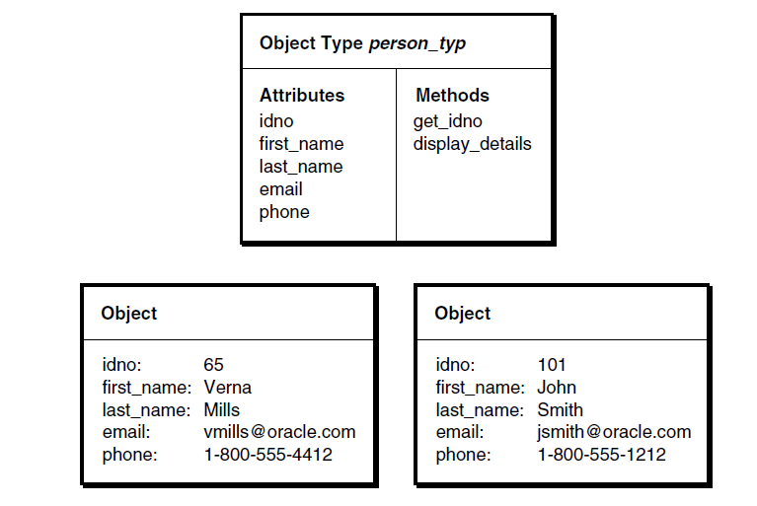
An Object Type and Object Instances

Slide 16
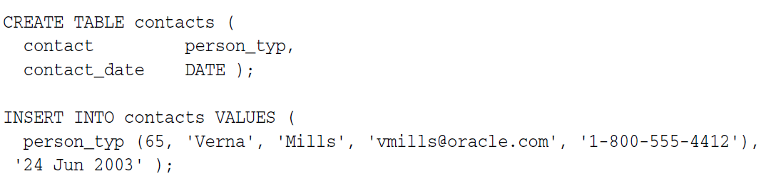
Object Type
When you create a variable of an object type, you create an instance of the type and the result is an object. An object has the attributes and methods defined for its type.
Because an object instance is a concrete thing, you can assign values to its attributes and call its methods.
You use the CREATE TYPE statement to define object types.

Slide 17
Object Tables
An object table is a special kind of table in which each row represents an object.

Slide 18
References
A REF is a logical pointer to a row object that is constructed from the object identifier (OID) of the referenced object and is an Oracle built-in data type.
REFs and collections of REFs model associations among objects, particularly many-to-one relationships, thus reducing the need for foreign keys.
REFs provide an easy mechanism for navigating between objects. You can use the dot notation to follow the pointers.
Oracle does joins for you when needed, and in some cases can avoid doing joins.
You can use a REF to examine or update the object it refers to.
You can also use a REF to obtain the object it refers to.
You can change a REF so that it points to a different object of the same object type hierarchy or assign it a null value.

Slide 19
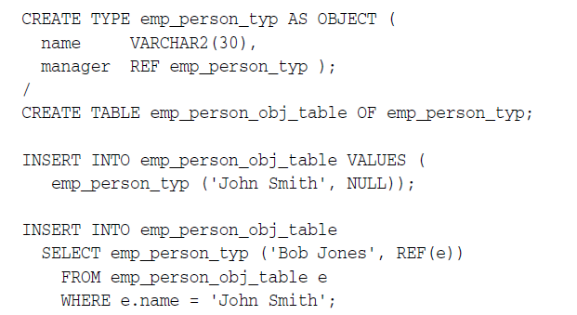

Slide 20
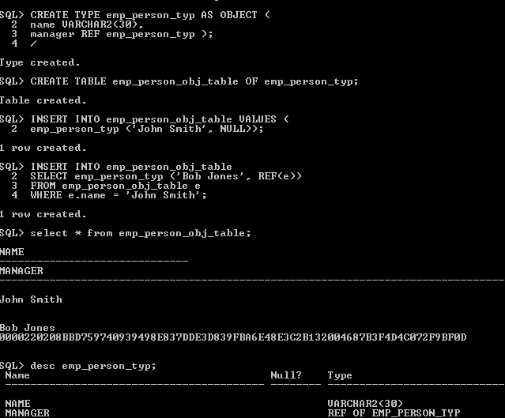

Slide 21
Write down an object-relational implementation

Slide 22
Implementation
Create or replace type student_ty as object (
stud_id number(4),
stud_name varchar(20) )
/
Create or replace type course_ty as object (
course_id number(4),
course_name varchar(20) )
/

Slide 23
Implementation
Create or replace type enrolls_in_ty as object (
student ref student_ty,
course ref course_ty
)
/

Slide 24
Implementation
Create or replace type office_ty as object (
office_id number(4),
building_name varchar(20)
)
/
Create or replace type lecturer_ty as object (
lect_id number(4),
lect_name varchar(20),
office ref office_ty
)
/

Slide 25
Implementation
Create table student of student_ty(
stud_id primary key);
Create table course of course _ty;
Create table enrolls_in of enrolls_in_ty;
Create table lecturer of lecturer _ty;
Create table office of office_ty;
insert into student values(1234,'Ram’);
insert into course values(2345,'DBMS’);
insert into enrolls_in values (
(select ref(s) from student s where s.stud_id ='1234'),
(select ref(c) from course c where c.course_id ='2345')
);

Slide 26
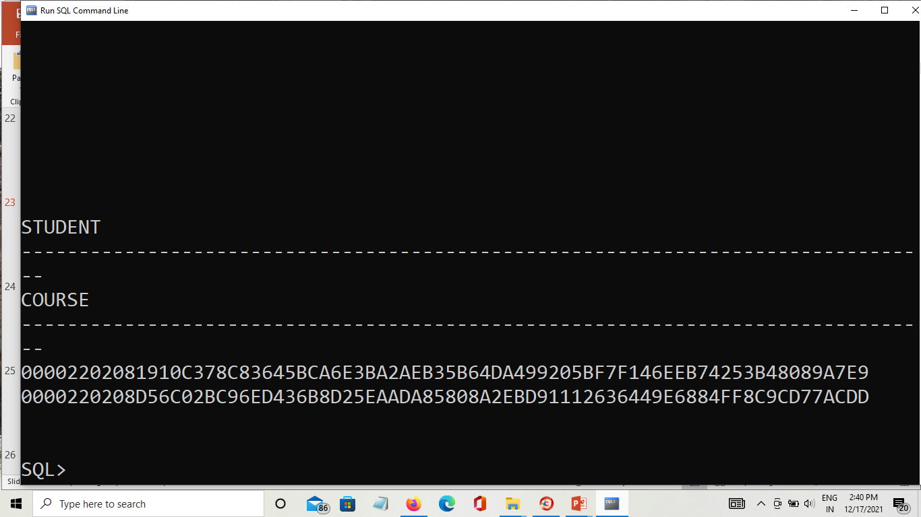
OUTPUT

Slide 27
Nested tables & References
DEPARTMENT(Dnumber, Dname, Manager, {Employees(Eid, Name, Salary)}
)

Slide 28
Object relational implementation
Create or replace type employee_ty as object (
Eid number(6),
Name varchar(30),
Salary number(8) )
/
Create or replace type employee_nt_ty as table of employee_ty
/

Slide 29
Object relational implementation
Create table department (
Dnumber number(2),
Dname varchar(20),
Manager ref employee_ty,
Employees employee_nt_ty
) nested table employees store as employee_nt;

Slide 30
Data entry
insert into department values(2, 'Estate', null,
employee_nt_ty (
employee_ty('1234', 'sij', 20000),
employee_ty('1235', 'fof', 40000)
)
);

Slide 31
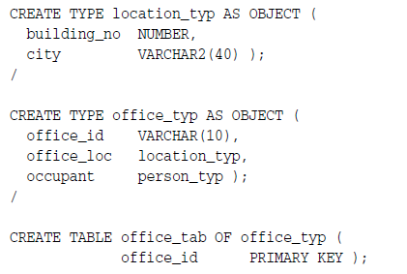
Constraints for object Table

Slide 32
A relational schema
CUSTOMER(Cus_code, Cus_fname, Cus_lname, Cus_balance)
INVOICE(Inv_no, Cus_code, Inv_date, Inv_amount)
LINE(Inv_no, Line_no, P_code, Line_units, Line_price)
PRODUCT(P_code, P_desc, P_qoh, P_min, P_price, V_code)
VENDOR(V_code, V_name, V_Contact)
The primary keys are underlined and foreign keys are self-explanatory.

Slide 33
Multi level nesting
CUSTOMER(Cus_id, Cus_name, Cus_mobile, {Invoices(Inv_no, Inv_date, Inv_amt, {Lines(Ln_no, Product, Units)} }
PRODUCT(Prd_id, Prd_name, Prd_desc, Price)

Slide 34
Multi level nesting
Create or replace type product_ty as object (
prd_id number(6),
prd_name varchar(20),
prd_desc varchar(30),
price number(6,2)
)
/
Create table product of product_ty;

Slide 35
Multi level nesting
Create or replace type line_ty as object (
ln_no number(4),
product ref product_ty,
units number(3)
)
/
Create or replace type line_nt_ty as table of line_ty
/

Slide 36
Multi level nesting
Create or replace type invoice_ty as object (
lnv_no number(4),
Inv_date date,
Inv_amt number(3),
lines line_nt_ty
)
/
Create or replace type invoice_nt_ty as table of invoice_ty
/

Slide 37
Multi level nesting
Create table customer (
cus_id number(6),
cus_name varchar(20),
cus_mobile number(10),
invoices invoice_nt_ty
)
nested table invoices store as invoice_nt
(nested table lines store as line_nt);

Slide 38
Data entry
insert into customer values( '1234567891', 'ajfejfj',
inv_nt_ty(
inv_ty('1234', sysdate, 2000,
ln_nt_ty(
ln_ty('1234', '2456', 3, 20),
ln_ty('2224', '3345', 4, 30),
ln_ty('2353', '3456', 4, 40) )
),
inv_ty('2345', sysdate, 3000,
ln_nt_ty(
ln_ty('5678', '1234', 3, 40),
ln_ty('4234', '4327' , 4, 56))
)
)
);

Slide 39
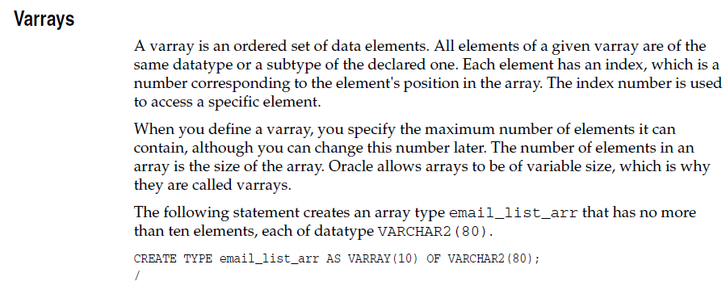

Slide 40

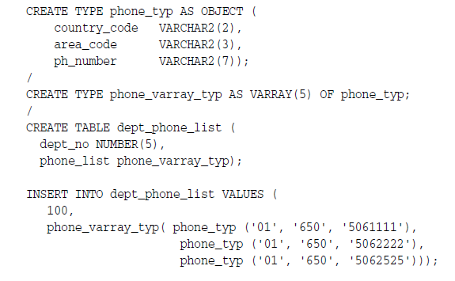

Slide 41
Inheritance in SQL Object Types
A type hierarchy is a sort of family tree of object types.
It consists of a parent base type, called a supertype, and one or more levels of child object types, called subtypes, derived from the parent.
Subtypes in a hierarchy are connected to their supertypes by inheritance.
This means that subtypes automatically acquire the attributes and methods of their parent type.
It also means that subtypes automatically acquire any changes made to these attributes or methods in the parent: any attributes or methods updated in a supertype are updated in subtypes as well.

Slide 42
Types and Subtypes
A subtype can be derived from a supertype either directly, or indirectly through intervening levels of other subtypes.
A subtype can directly derive only from a single supertype: it cannot derive jointly from more than one.
A supertype can have multiple sibling subtypes, but a subtype can have at most one direct parent supertype.
In other words, Oracle supports only single inheritance, not multiple inheritance.

Slide 43
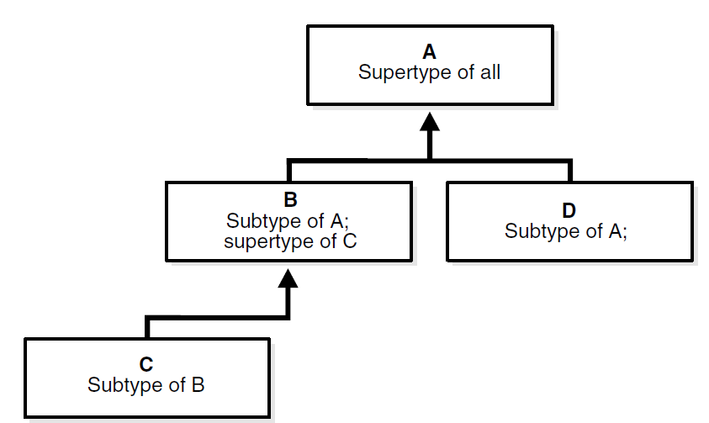

Slide 44
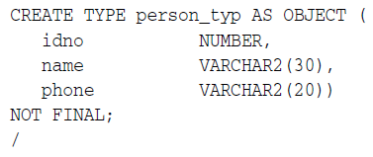
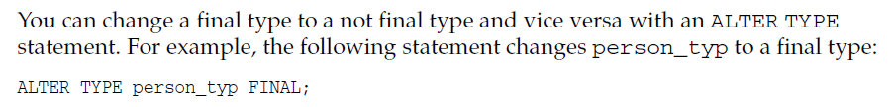
FINAL and NOT FINAL Types and Methods
The definition of an object type determines whether subtypes can be derived from that type.
To permit subtypes, the object type must be defined as not final.
This is done by including the NOT FINAL keyword in its type declaration.

Slide 45
